Slide 1
Wireless Broadband 101:
Technologies, capabilities and potential use cases

Slide 2
A Public Utility Consortium Serving Washington State with Broadband and Next Generation 911 Services
How the Northwest connects
Greg Berry
Senior Network Design Engineer
Sean Ogden
Wireless Design Engineer

Slide 3
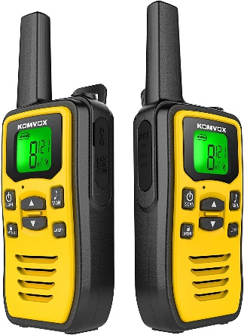
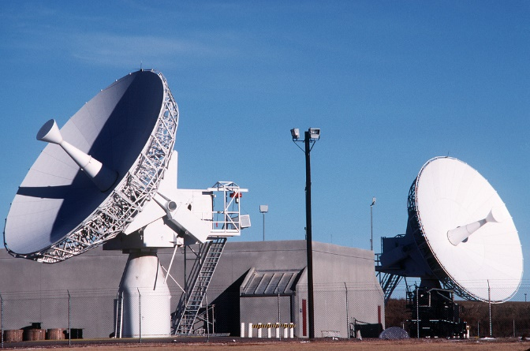
What is Wireless Communication?
TRANSMISSION OF INFORMATION USING RADIO WAVES
Two-Way Radio (Transmit and Receive)
Walkie Talkie
Bluetooth
Wi-Fi
Cellular Networks
Satellite

Slide 4
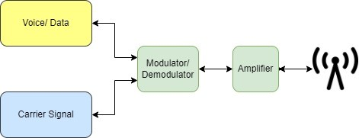
How does it work?
RADIO FUNDAMENTALS
Different Radios for different jobs (Throughput, Range, Environment)
Bluetooth – 30 feet, low bandwidth
Wi-Fi – 50 yards, 1Gbps+
Cellular (4G/5G) – A few blocks to ~10 miles, 1Gbps+
PtP (Point to Point) Microwave – 50 miles+, 1Gbps+
Satellite – Global, 100mbps*

Slide 5
How does it work?
A RADIO’S PERFECT WORLD
Clear line of site on a cool night
Distance, Infrastructure, Weather, Foliage, Terrain, and RF Interference all effect performance.
Lower Frequencies Propagate Better but have lower throughput
Wi-Fi
2.4ghz vs 5ghz
Cellular
4G (700mhz, 800mhz, 2300mhz)
5G (low band <1ghz, mid band 1-6ghz, high band 24-40ghz)
Higher Frequencies = more towers
Fast Backhaul
Preferably fiber
Wireless backhaul (to fiber) can achieve 2Gbps+

Slide 6
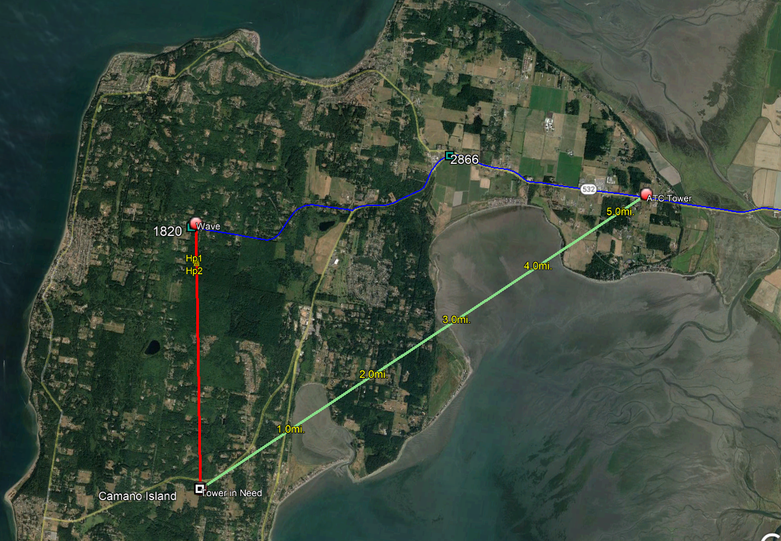
How does it work?
PATH INVESTIGATION

Slide 7
How does it work?
PATH INVESTIGATION

Slide 8
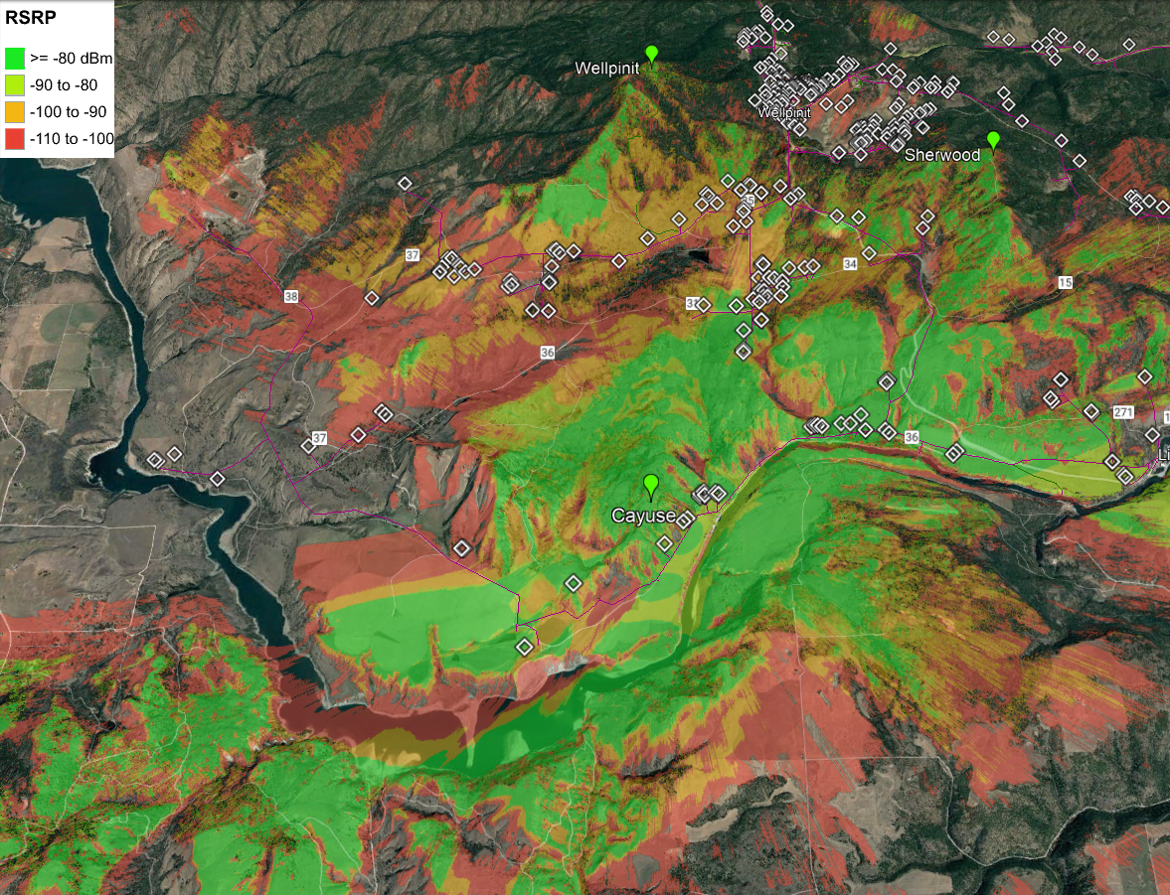
How does it work?
HEAT MAP

Slide 9
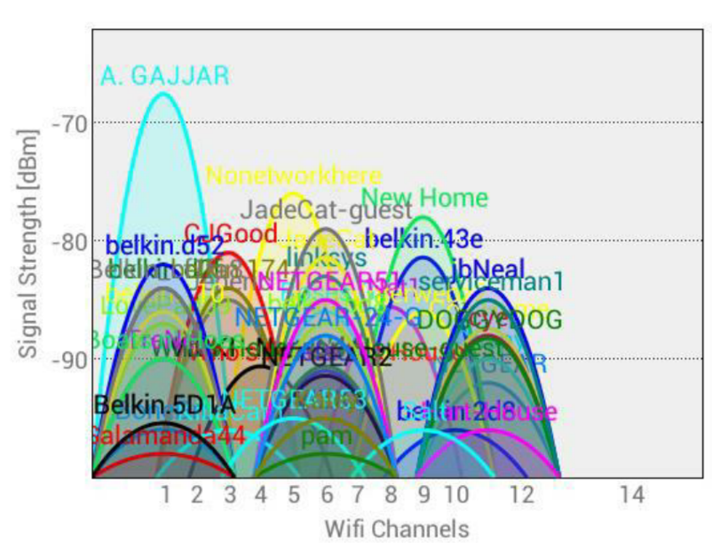
How does it work?
RF SPECTRUM
Spectrum is the range of electromagnetic radio frequencies used to transmit sound, data, and video across the country.
Extremely valuable (100’s of Billions)
FCC designates use across entire range
Military, First Responders, Designated groups have priority
Sold through auctions, Lobbied
Licensed, Unlicensed, Light Licensed
Licensed – Spectrum range is formally
coordinated and strictly controlled.
Interference is actively mitigated.
Unlicensed – Anyone can use. Wi-Fi
Lightly Licensed – Access is controlled
but easily obtained

Slide 10
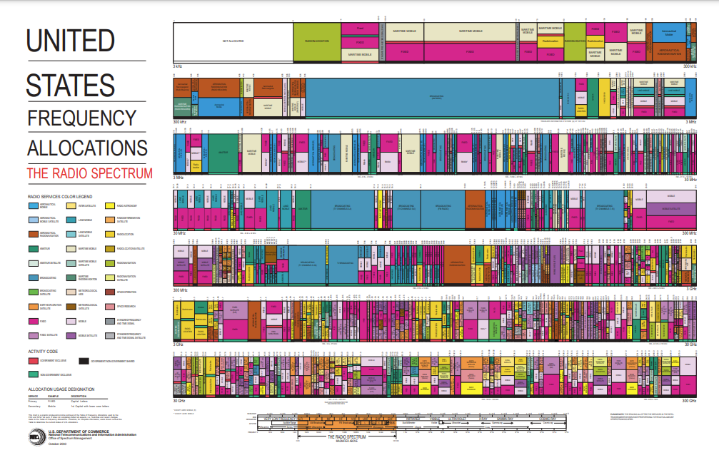
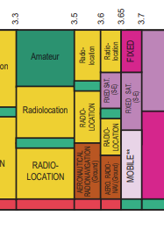
How does it work?
RF SPECTRUM

Slide 11
Why choose Wireless Broadband?
WIRELESS BENEFITS
Cover large area with single site
Usually cheaper than cabling to each location
Faster deployment
Fiber supply Issues
1-4 Year timeline on fiber projects
Do not need dedicated tower
Water Towers
Buildings
Customer equipment is minimal

Slide 12
Types of Wireless Broadband Networks
FIXED, MOBILE, SATELLITE
(25Mbps Download, 3Mbps Upload)
Fixed Wireless – Both points fixed, nothing moves
WISP
Licensed and Unlicensed
Easily deployable
Mobile Wireless – At least one point is mobile
Most Common (Cellular)
Constantly upgraded
Satellite – Only recently offered broadband speeds (Low Earth Orbit-Starlink)
Most expensive
Typically for very remote areas
Very limited resources, not easily upgraded

Slide 13
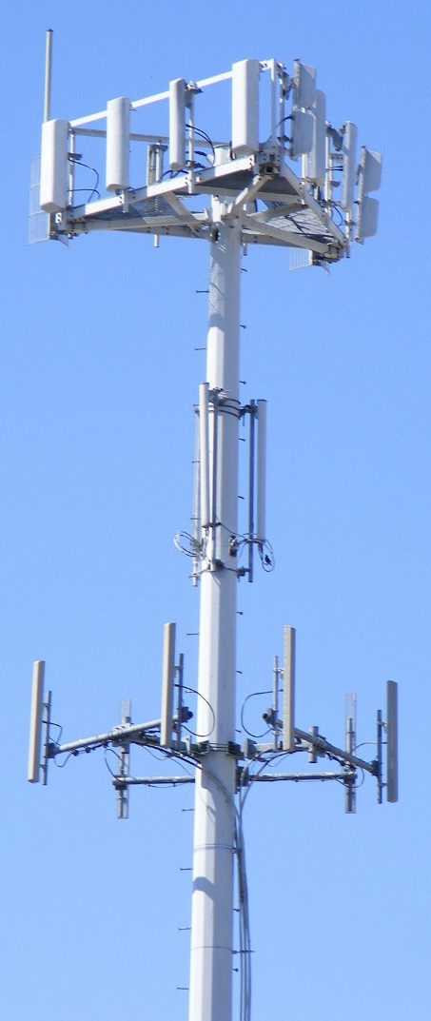
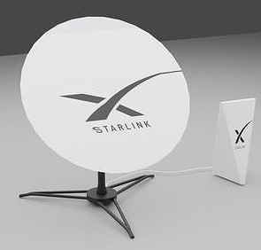
Wireless Broadband Around Town
FWA using Water Tower
Fixed Wireless CPE
Satellite Dish
Multiuse Tower

Slide 14
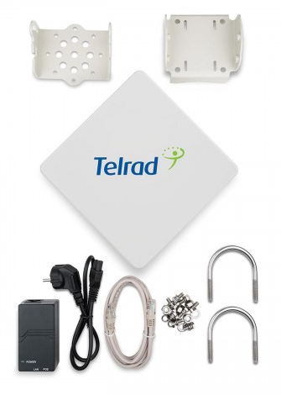
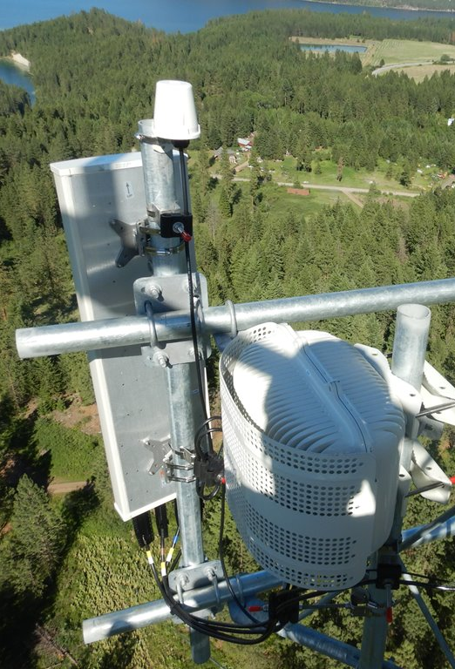
NoaNet Wireless Broadband Deployment

Slide 15
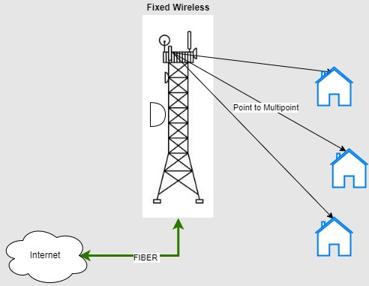
Wireless Broadband Architecture
FIXED WIRELESS ACCESS SCENARIO 1

Slide 16
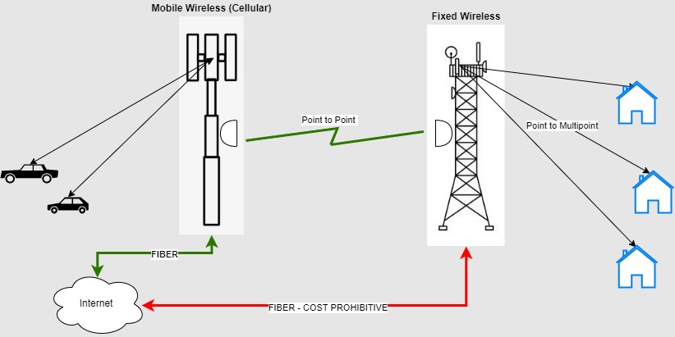
Wireless Broadband Architecture
FIXED WIRELESS ACCESS SCENARIO 2

Slide 17
Wireless Broadband Networks
2.5 GHz
BRS/ EBS (Broadband Radio Service/ Educational Radio Service)
Spectrum released from reserved but underused bands
Sold via auction (all licensed)
T Mobile primary incumbent
Carriers pushing for another auction in 2022
Tribal Priority Window
Tribes could get priority access to spectrum
Ended September 2020
Current deployments in CCT and STOI
Experience so far
Excellent propagation through cover and non-los
20 MHz = 110/12Mbps or 40 MHz = 220/24 using Carrier Aggregation

Slide 18
Wireless Broadband Networks
3.5 Ghz
CBRS (Citizens Broadband Radio Service)
Spectrum released from former Military spectrum
150 MHz made available
80 MHz available unlicensed
7-10MHz blocks per county
Three user tiers
Incumbent, PAL (Prior Access License), GAA (General Authorized Access) i.e., ‘lightly licensed’
Access controlled by FCC’s SAS (Spectrum Access System)
Certified installer requests spectrum with SAS
Each deployment registers with SAS to coordinate frequency
System monitors spectrum via ESC (Environmental System Capability) onboard each device
SAS operated by consortium (Federated Wireless, Google, CommScope, Amdocs, and Sony)
NoaNet has test deployment in Tri-Cities

Slide 19
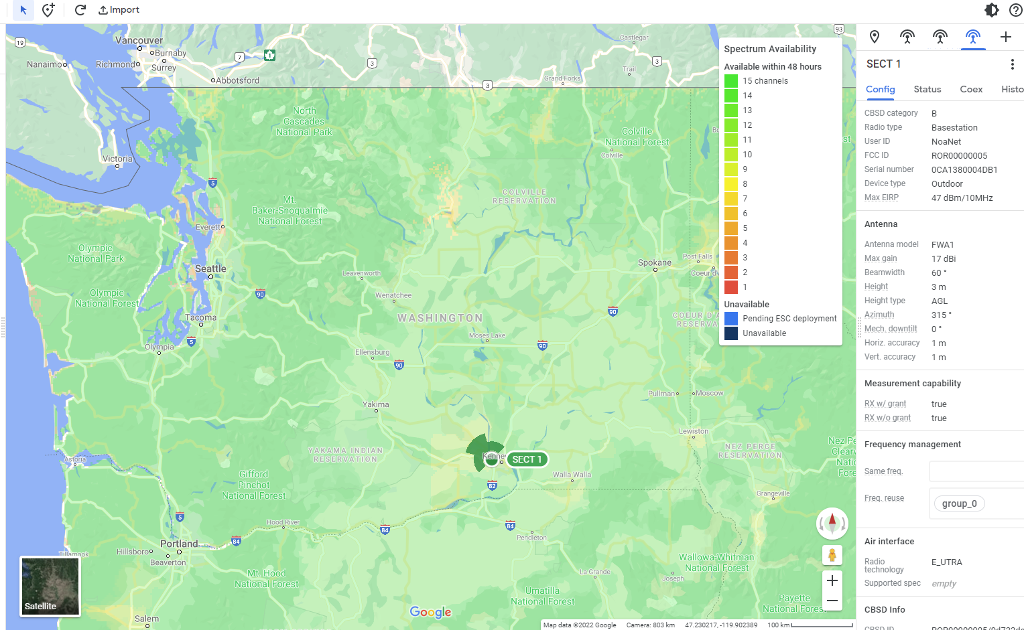
Wireless Broadband Networks
3.5 GHz
CBRS (Citizens Broadband Radio Service)

Slide 20
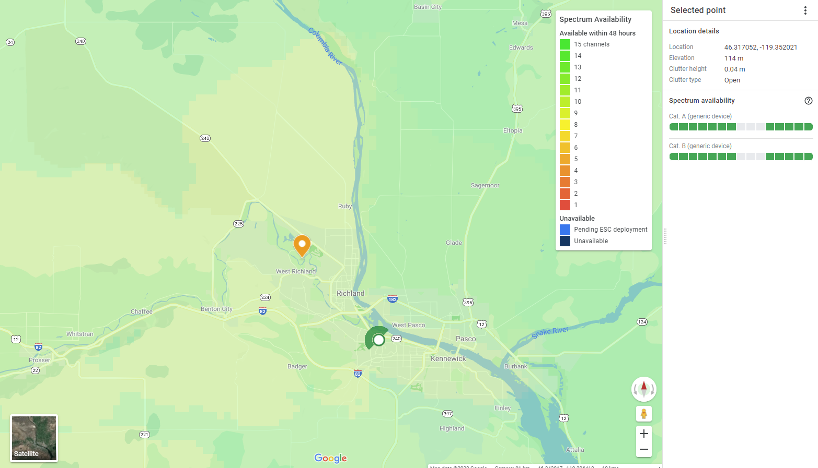
Wireless Broadband Networks
3.5 GHz
CBRS (Citizens Broadband Radio Service)

Slide 21
The Persistently Unserved
WHAT ABOUT THE AREAS THAT ARE STILL UNSERVED OR UNDERSERVED?
Difficult terrain requiring trenching or boring can be cost prohibitive
Low population density to recoup the investment made through the sale of services makes investment not feasible
Subsidization will be required for the areas that are still unserved in our state. If there was a way to make it work without significant capital infusion, it would have happened by now!
IT’S NOT JUST ABOUT NETWORK
The Digital Divide is not a rural/urban issue- it is more complex
Affordability, access to technology and know-how can be as big of a barrier as lack of network availability.
We are in a time of unprecedented funding for broadband and communities across the state are stepping up!

Slide 22
Thank you. Bring on the Questions! Sean Ogden & Greg Berry SOgden@noanet.net & Greg.Berry@noanet.net

Slide 23
References
RF Fundamentals
Radio Transmission - https://www.youtube.com/watch?v=FWCN_uI5ygY&list=RDCMUCqZQJ4600a9wIfMPbYc60OQ&index=8&ab_channel=Lesics
Modulation - https://www.youtube.com/watch?v=Iyzpt3bKTTI&ab_channel=Lesics
Spectrum - https://www.youtube.com/watch?v=DXt-rXDu9M8&ab_channel=Lesics
FCC Broadband Definition - https://www.fcc.gov/consumers/guides/broadband-speed-guide
3.5 GHz - CBRS - https://www.celona.io/cbrs/what-is-cbrs
Google SAS - https://www.google.com/get/spectrumdatabase/
2.5 GHz - https://www.techdirt.com/articles/20201203/08111545814/fcc-25-ghz-spectrum-tribal- priority-window-something-positive-amid-covid-19-pandemic.shtml

