Slide 1
KITSAP PUBLIC UTILITY DISTRICT
NoaNet Broadband 101
November 30, 2021
Notes:
Thank you for the opportunity to be here. We have lots

Slide 2
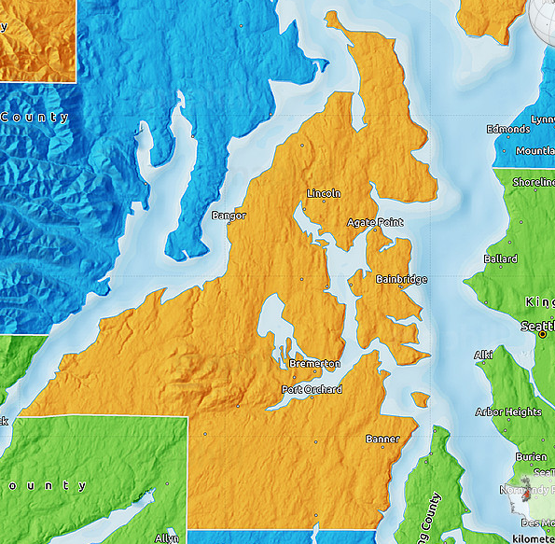
Mapping the Broadband Access Problem
Kitsap PUD Broadband History
Broadband Need and Demand
Mapping Kitsap County Broadband Availability
COS Systems
Residential Expansion
Maps Supporting COVID Response
Lessons Learned and Next Steps
Mapping the Broadband Network
Operations and Maintenance
Expansion

Slide 3
Kitsap PUD – Broadband History
Kitsap County – 3 Incumbent Local Exchange Carriers (Telephone Companies)
CenturyTel, Qwest, Embarq
Long Distance between Schools within District
KPUD telecom utility was created using long term bonds
Built a figure 8 backbone infrastructure in Kitsap County
Connecting schools, libraries, and other anchor institutions
Currently Provide - Carrier transport, Kitsap naval bases, cell tower backhaul, Small business customers
Committed to maintaining a community owned high-speed open-access fiber optic network

Slide 4
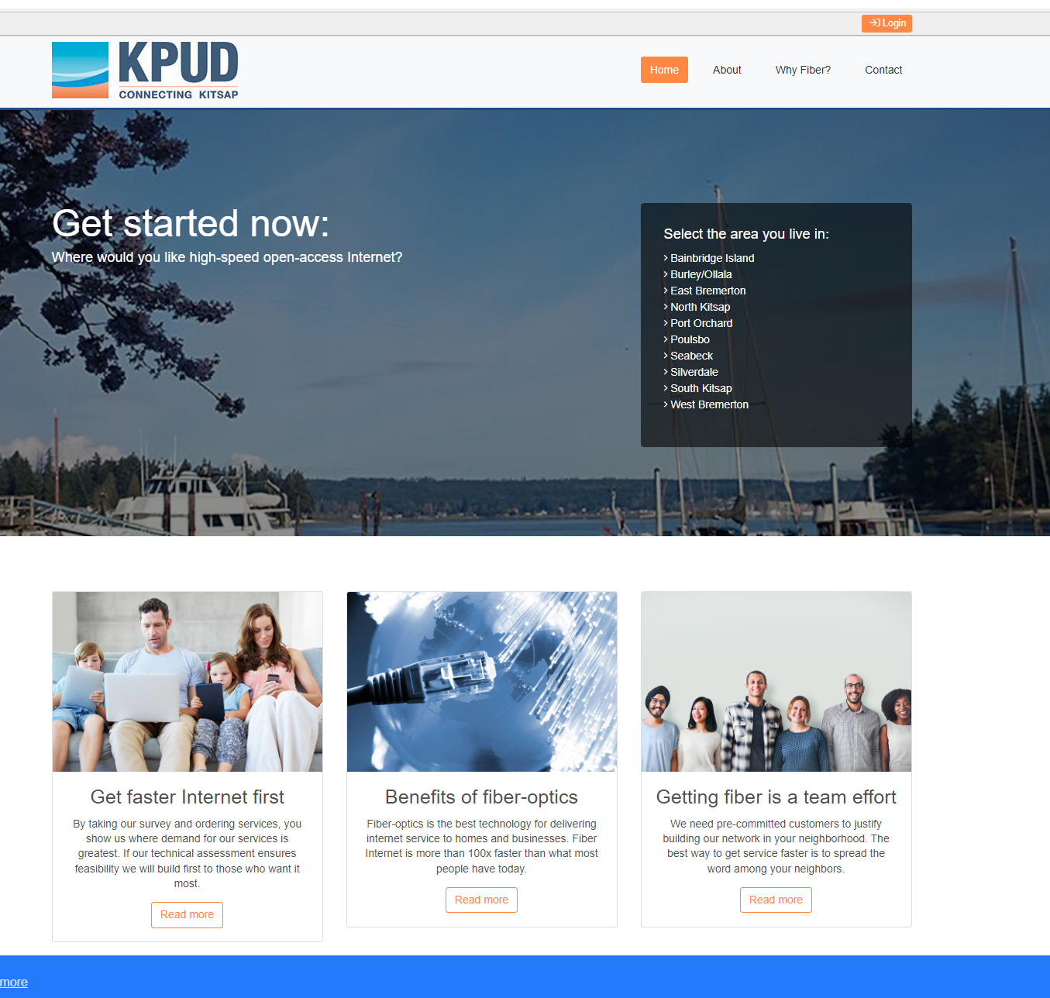
Determining Residential Broadband Need
2015 Residents began requesting Fiber to the Home Services
Board of Commissioners Approved Studying the availability of Broadband
Evaluated and purchased COS Service Zones to survey the County
Received 2,000 responses within a month
2016 Installed distribution cabinets and established the residential network – separate from the express network

Slide 5
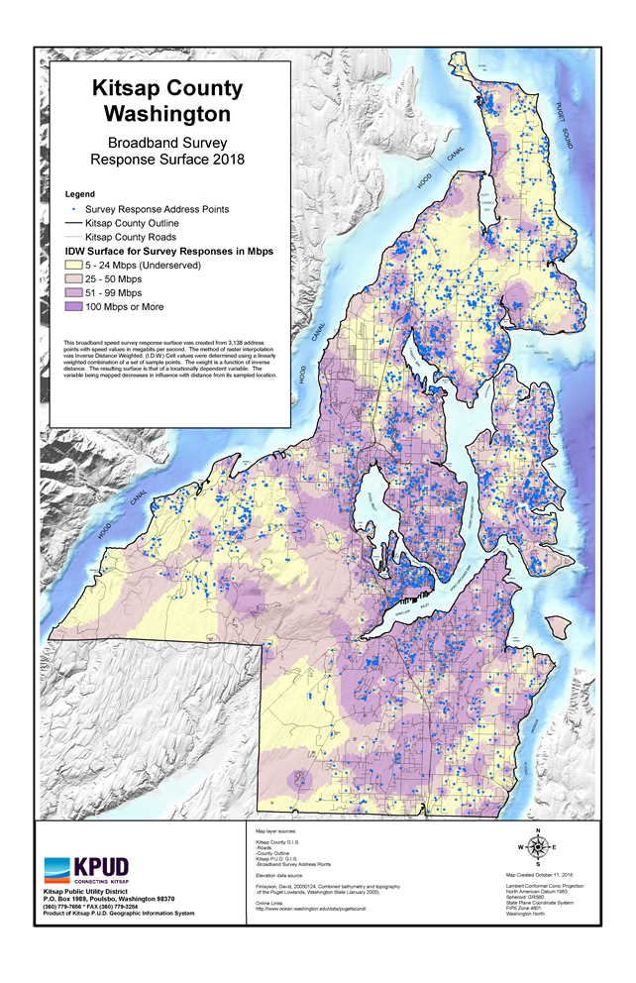
Mapping the Need - 2018
KPUD GIS Staff Created Heat Map
3,138 Survey responses
Yellow Unserved < 25Mbps
Light Purple Underserved 25 – 50Mbps
Purple 51 – 99 Mbps
Dark Purple > 100Mbps
Middle Mile Expansion
Focused on Unserved
Over 25 miles built in 2019 – serving over 500 residences
Over 48 miles built in 2020 – 2021 – service nearly 1200 residences

Slide 6
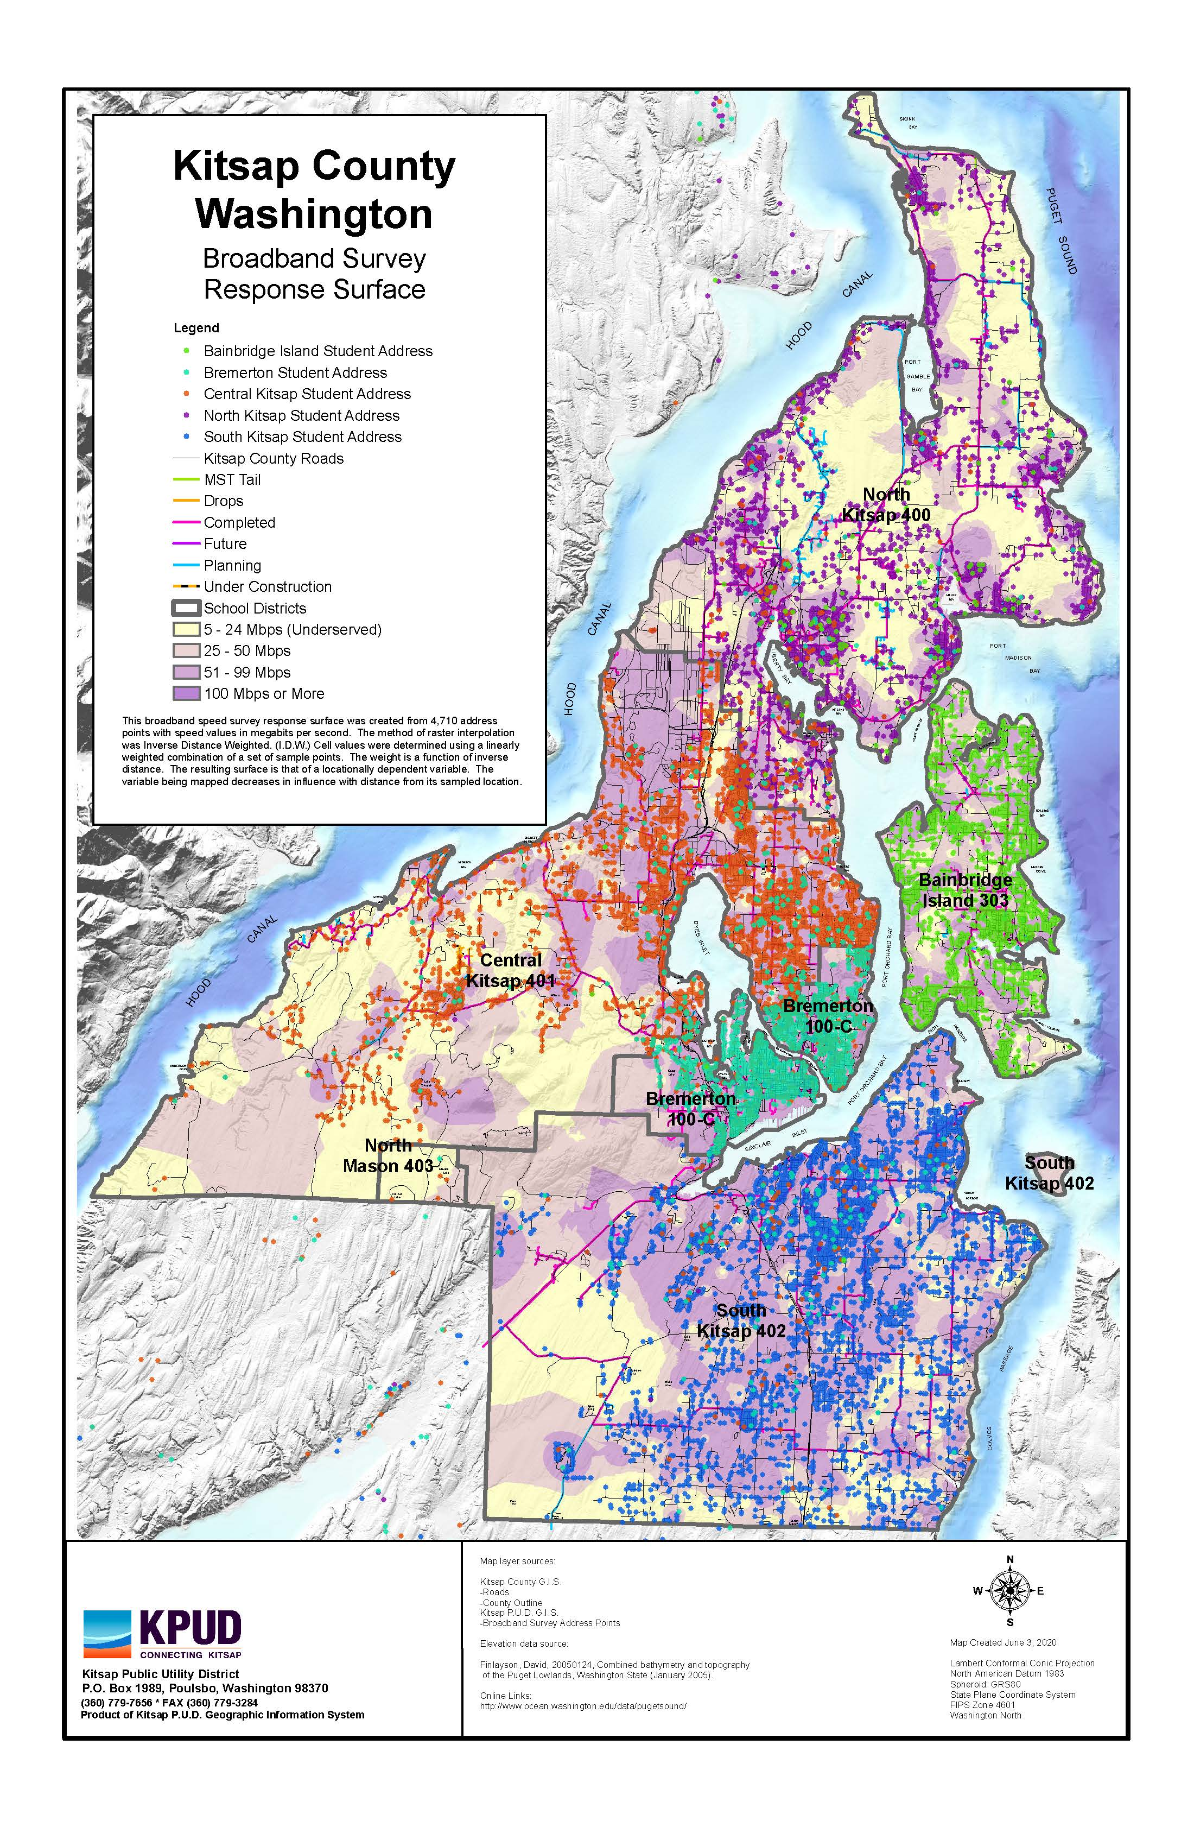
COVID Response
Stay Home Stay Healthy order
Students connecting to Broadband for Education
Strain on the existing networks in served areas
Coordinated with School Districts
Identified those students who are unserved due to lack of Infrastructure
Provided the data for support from the County and Schools Districts
Bond Funds to Virtually Complete Middle Mile
5 Year Middle Mile Plan based on Map

Slide 7
Data Driven Residential Expansion
Lessons Learned
Map provided a visual to see where the middle mile infrastructure was needed
Look to the future with speeds
Now <100Mbps is considered Underserved
Include Upload and Download
Upload became more important with COVID demand
Make the Survey CLEAR
Future Support Public Efforts for Mapping
Neutral Party

Slide 8
Mapping for Operations and Maintenance
Infrastructure mapping options abound
CresentLink, OSPInsight, Vetro, Fibermap, ESRI, etc.
Physical Fiber location and Fiber Count
Aerial vs Underground
Splice Cases and Splicing Diagrams
End User Information
Equipment Details
Need specialized staff to input data
Outage management
Emergency and Maintenance Announcements
Infrastructure mapping options abound
Capture as much information as you can when you start

Slide 9
Mapping for Sales
Need Easy to Manage Systems
Google Earth
Universal
Street View
Use existing Maps in a user-friendly way….
Accurate Data
Fiber availability

Slide 10
Thank You ourfiber@kpud.org
Heather Pauley
President Board of Commissioners
Central Kitsap
hpauley@kpud.org
Jim Civilla
Vice-President Board of Commissioners
South Kitsap
jcivilla@kpud.org
Debra Lester
Secretary Board of Commissioners
North Kitsap
debra@kpud.org
Bob Hunter
General Manager
bob@kpud.org
360-620-1260
Angela Bennink
Telecom Director
angela@kpud.org
360-626-7760

