Slide 1
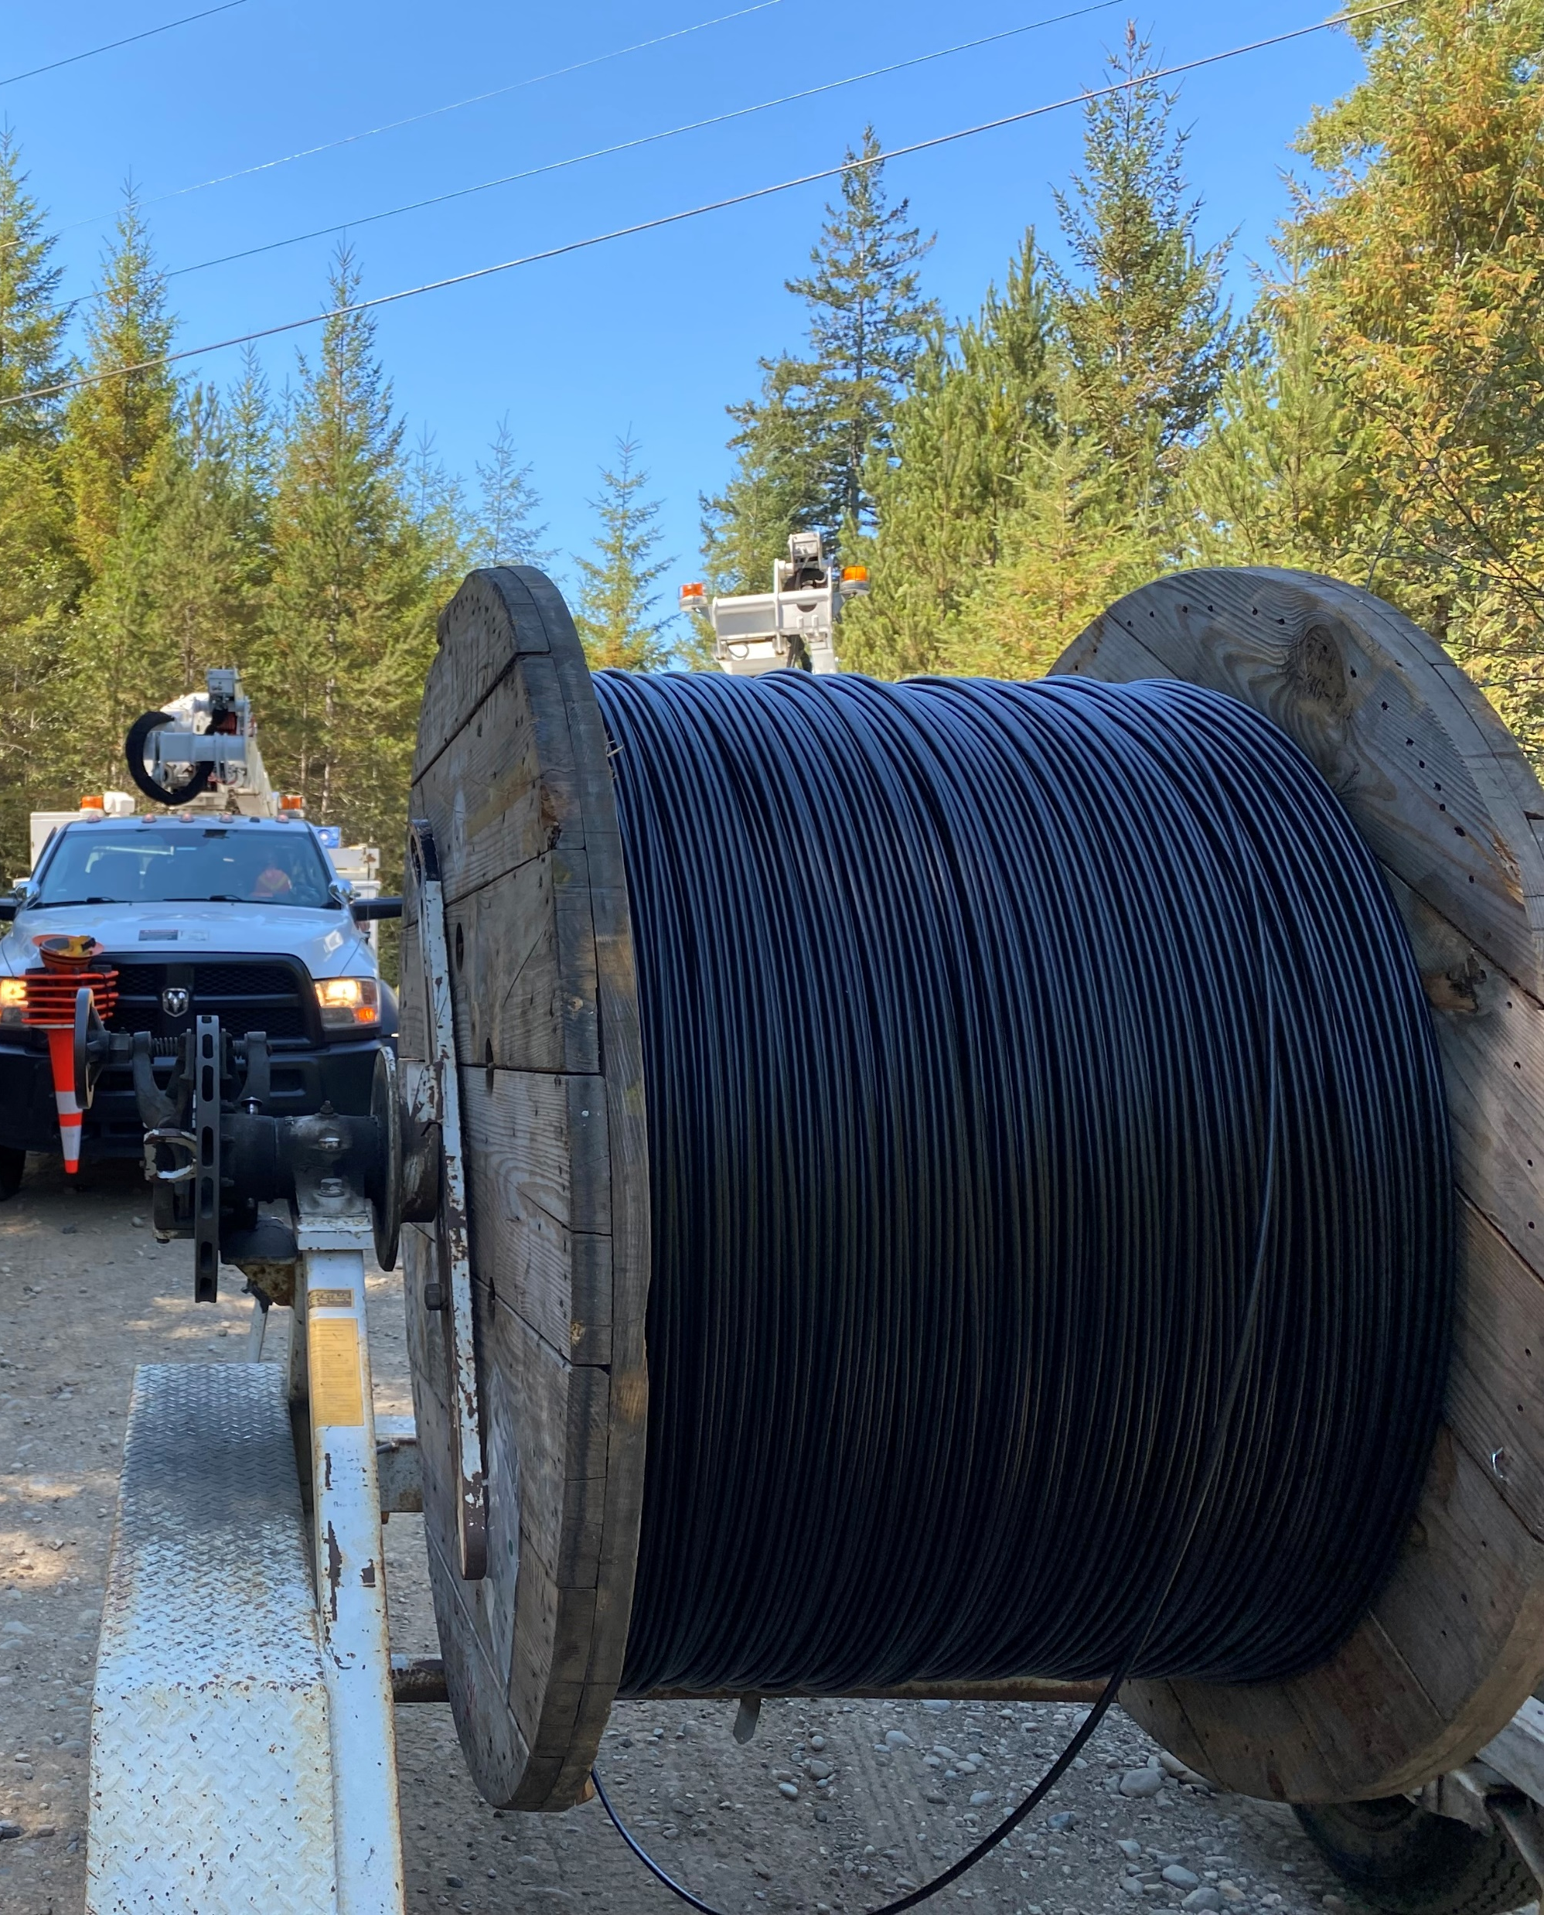
Mason PUD 3
Fiberhoods
business model

Slide 2
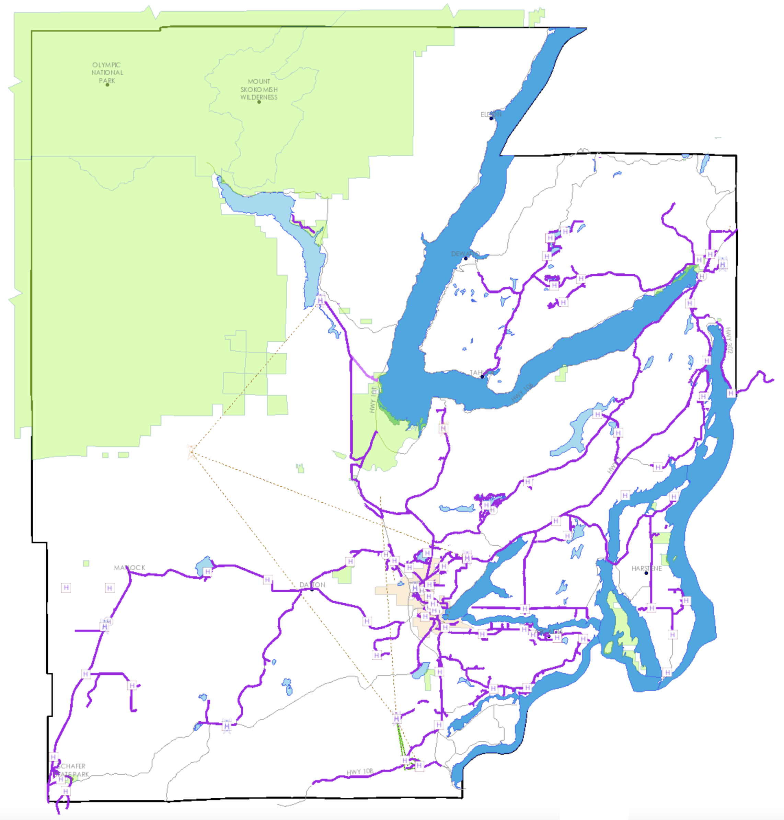
Mason PUD 3’s Fiber Network

Slide 3
how the Fiberhood
model works

Slide 4
Predefine “Fiberhoods”!
Unserved / Underserved
Near Existing Network
Overhead or Conduit Available
75% Commitment Level

Slide 5
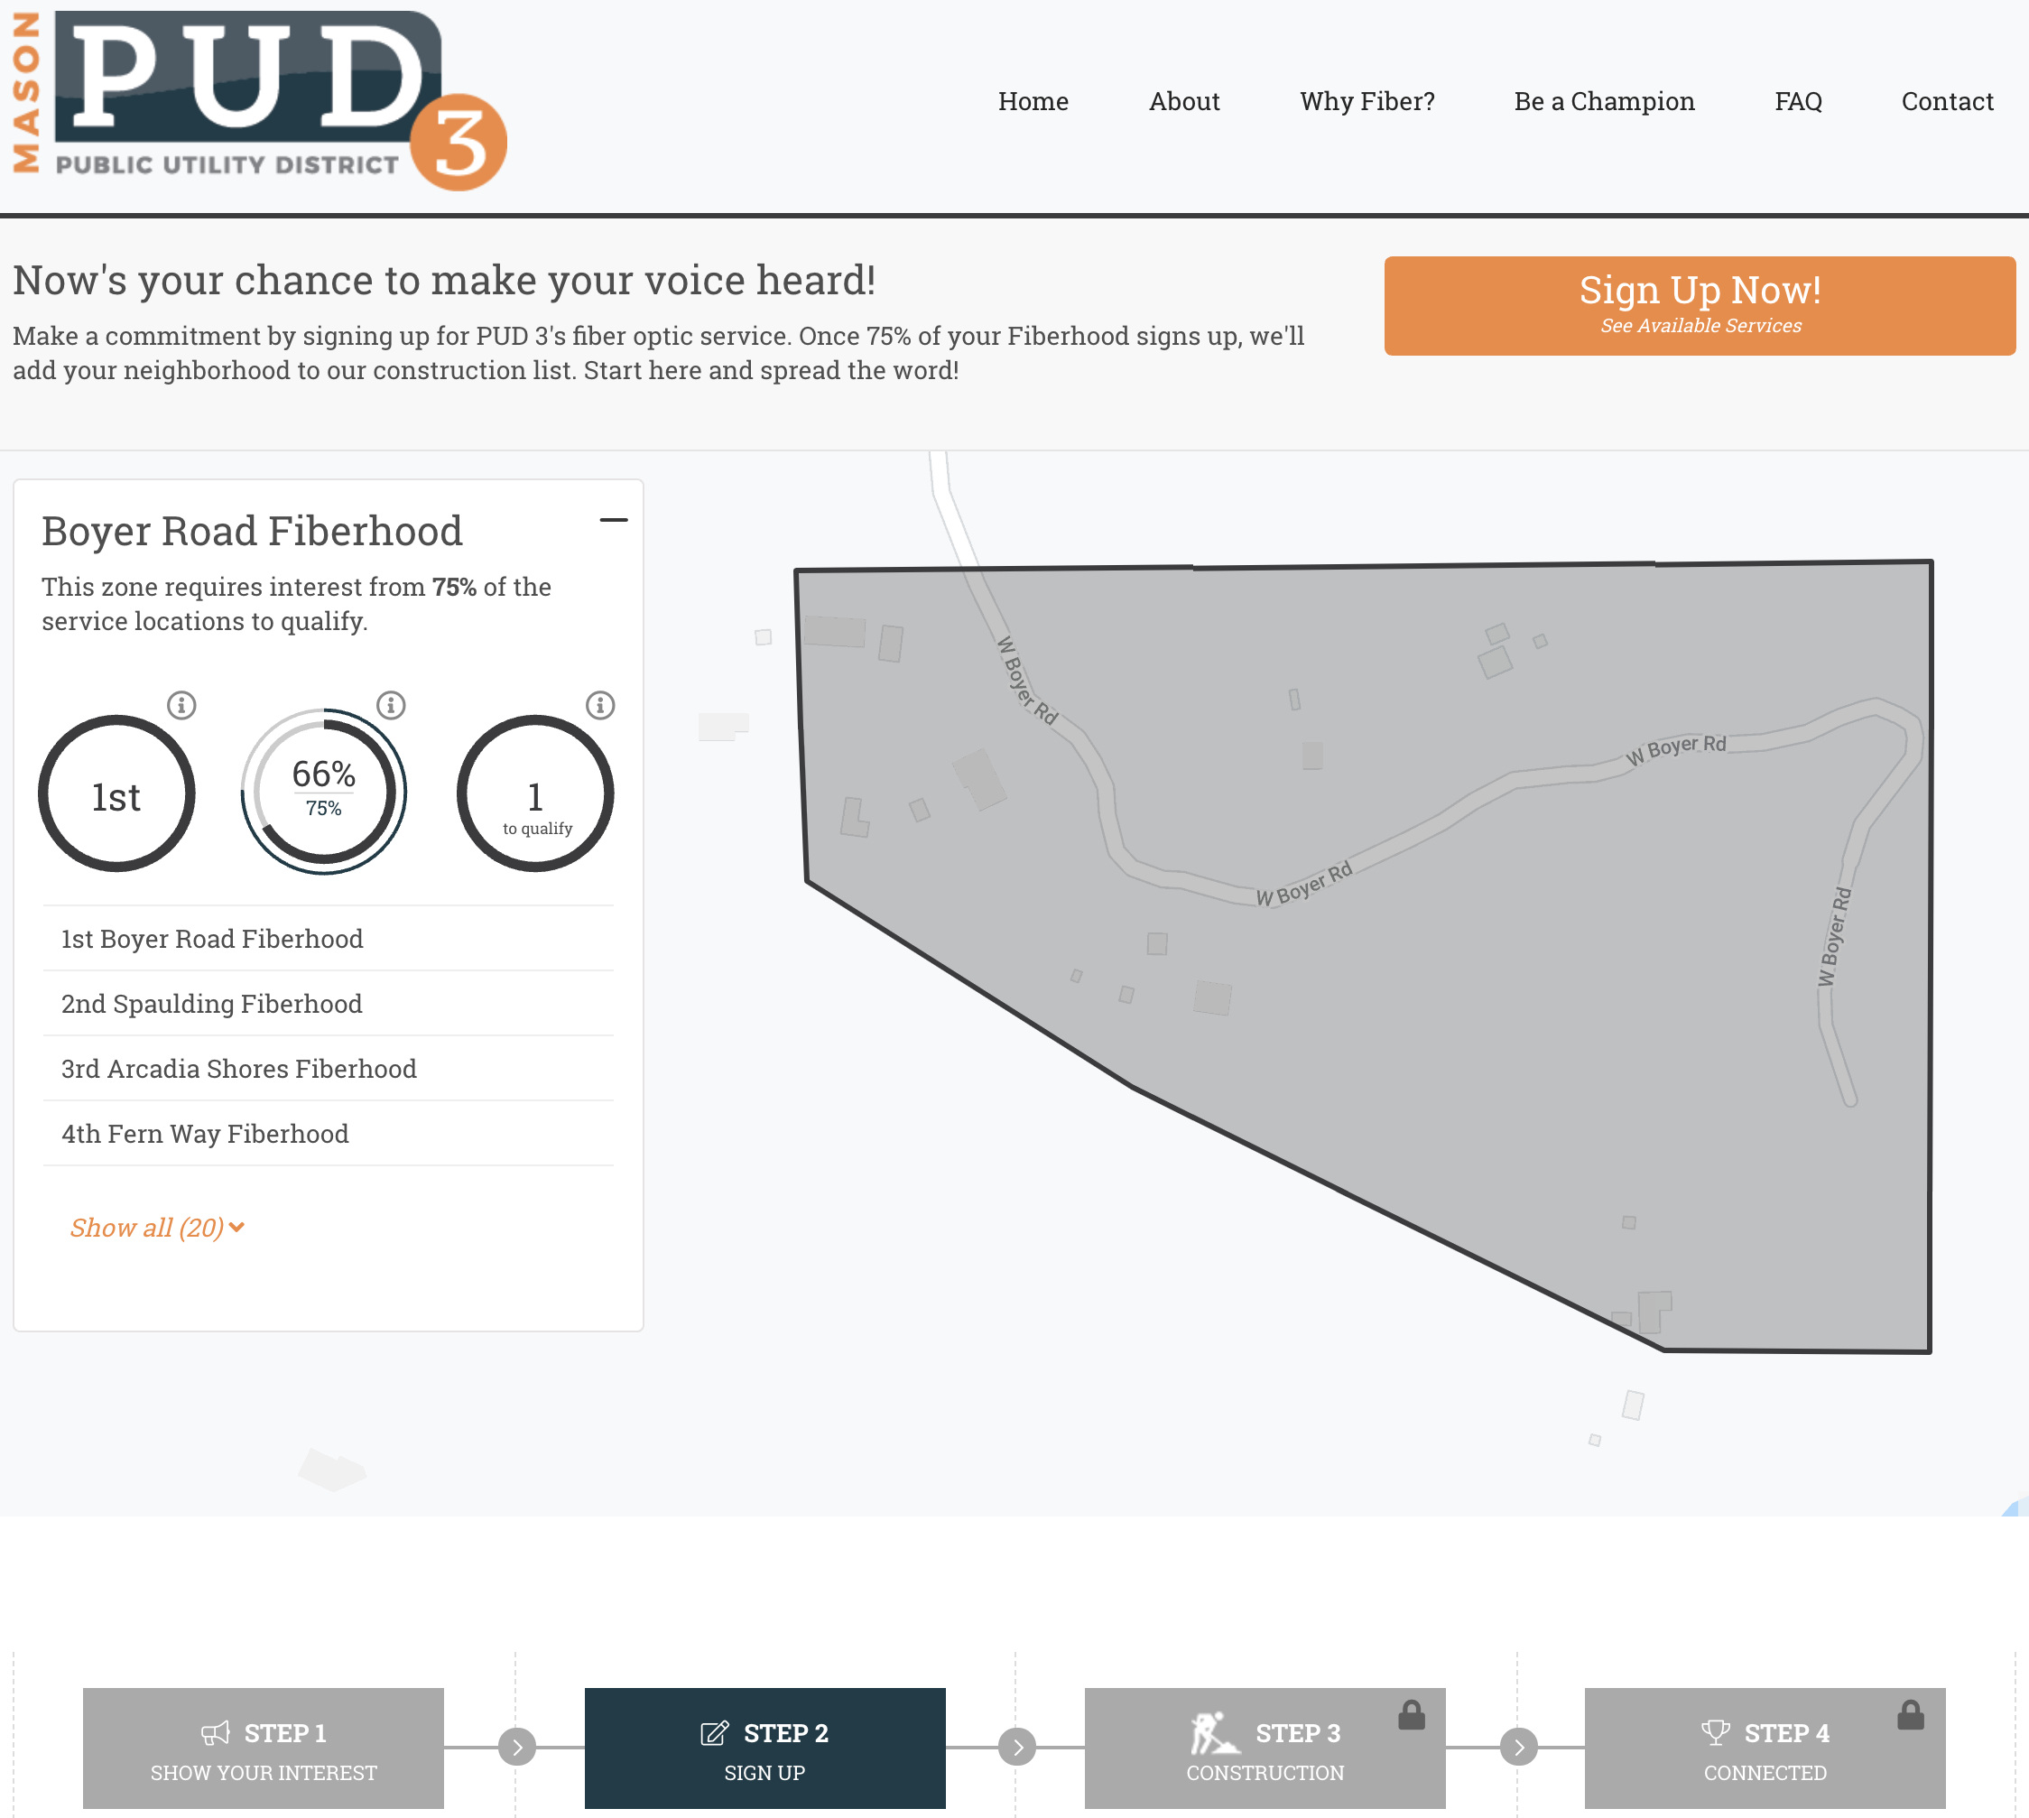
www.pud3.org/isfiberhere

Slide 6
How a “Fiberhood” is Paid For
$25 Construction Adder
Over 12 Years
Charged thru the Retail Service Provider
Only those who connect pay
Melded Rate Philosophy

Slide 7
where we are &
where we’re going

Slide 8
Current Situation and Future Needs
Construction Pipeline is FULL!
Fiberhoods, CERB Grants, RUS ReConnect Grant
Demand is still Great!
Additional Capital and Resources Needed as we make progress on our committed expansion projects.

Slide 9
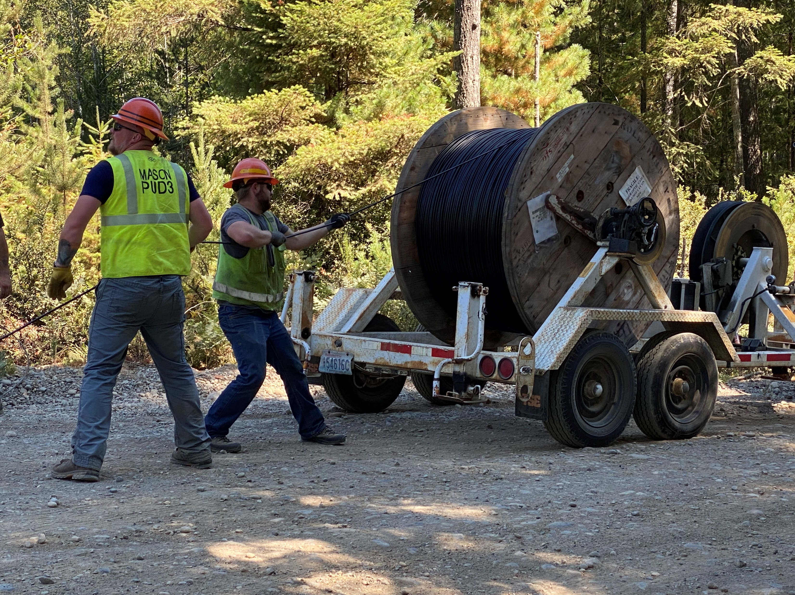
Questions?
www.pud3.org/fiberhood

